Slide 1
Real-time visualisation of flood extent
Charlotte Patterson, Owen Forbes, Larissa Patricio-Valerio, Matthew Tiller, Raiha Browning, Miguel Canizares, Leah South

Slide 2
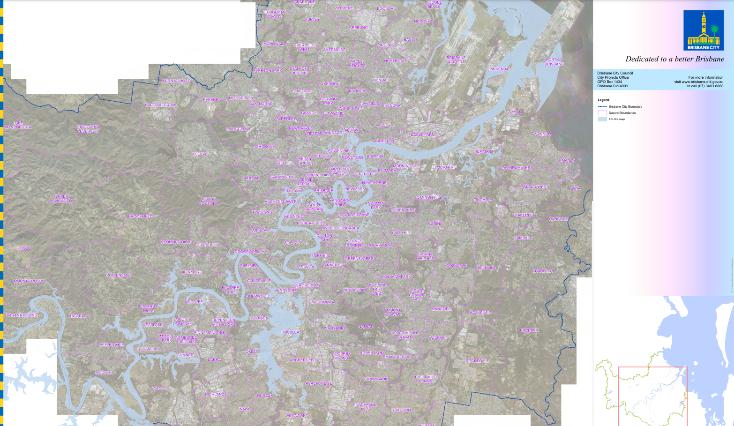
Notes:
Based on predicted high tide – if you live in the area highlighted in blue please make sure you’re prepared

Slide 3
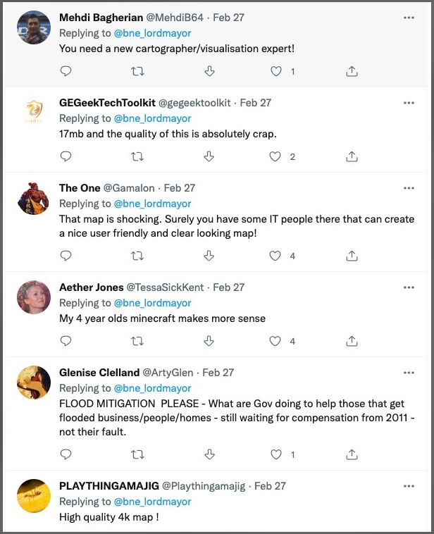

Slide 4
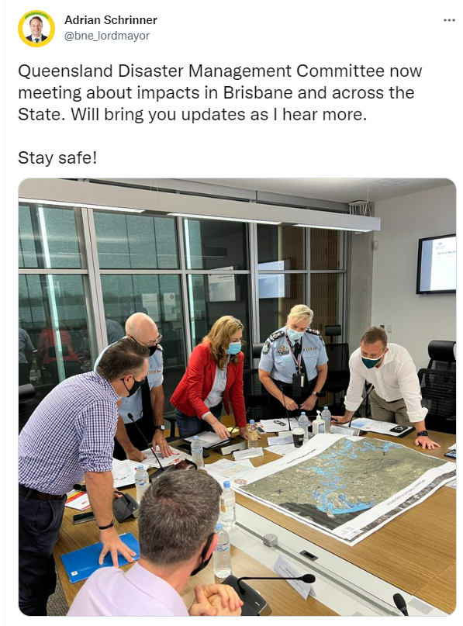

Slide 5
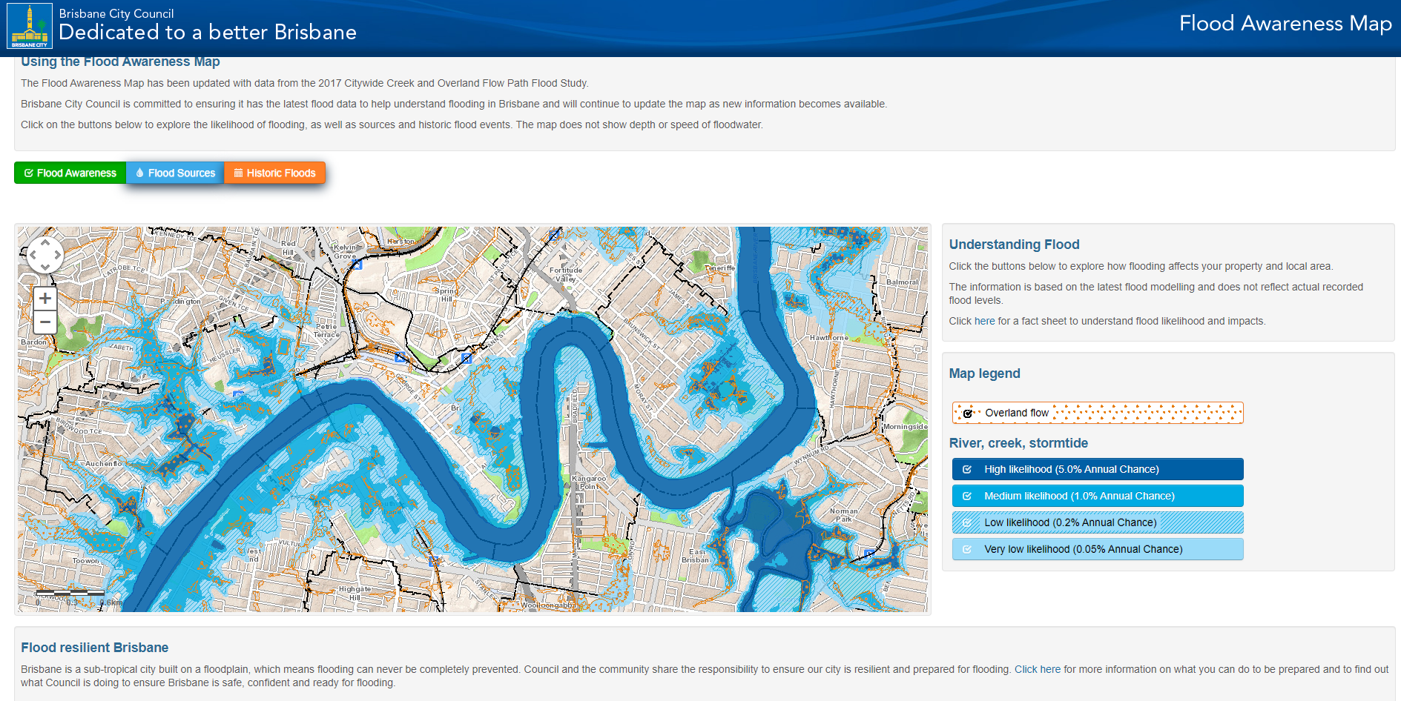

Slide 6
Notes:
1 in 100 assumes stationary climate
Intensity of rainfall / frequency will change type of flood

Slide 7
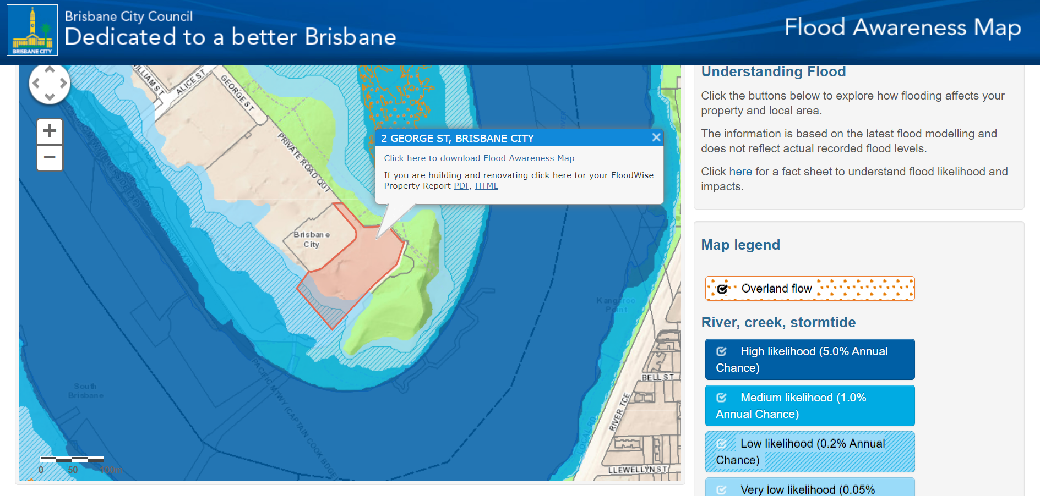

Slide 8
The problem
How can we leverage real-time information to provide useful flood extent information as the situation unfolds while appropriately communicating uncertainty?

Slide 9
The problem
How can we leverage real-time information to provide useful flood extent information as the situation unfolds while appropriately communicating uncertainty?
Create a hub of real-time and predicted flood extent information.
Our idea

Slide 10
What data were available?
Real-time visualisation:
River height data
25m DEM
Predictions and previous events:
Flood prediction PDF
Previous flood extent satellite imagery
Flood awareness map shapefiles

Slide 11
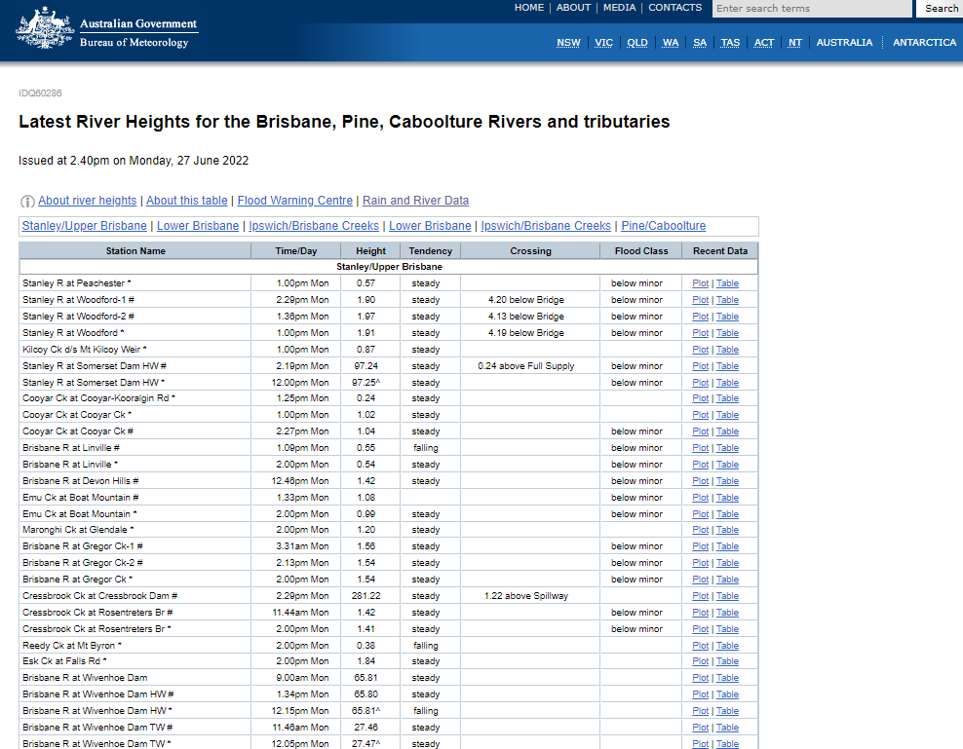
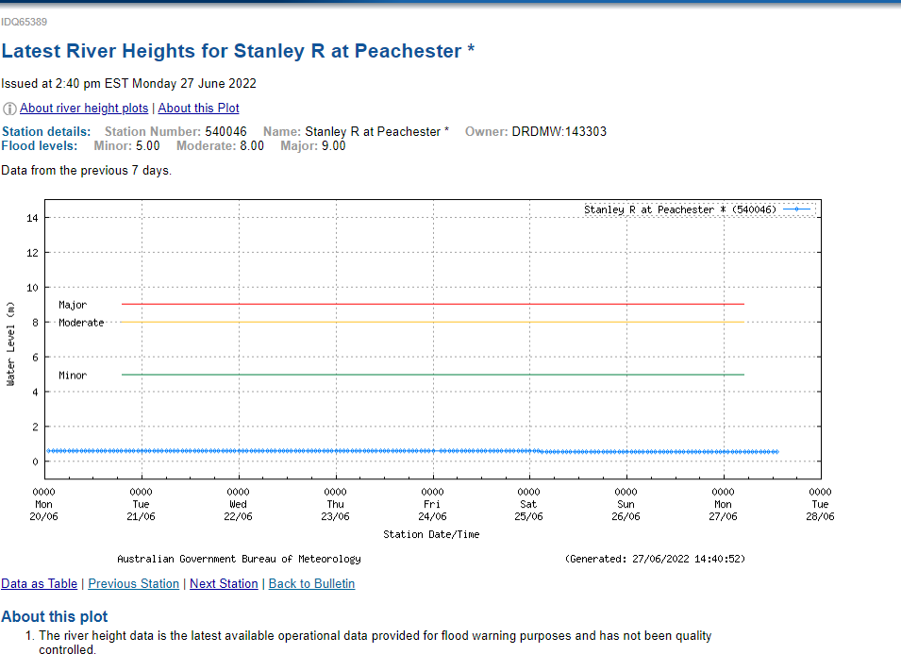
Notes:
So they have a tendency on them, but no clear map of where they are

Slide 12
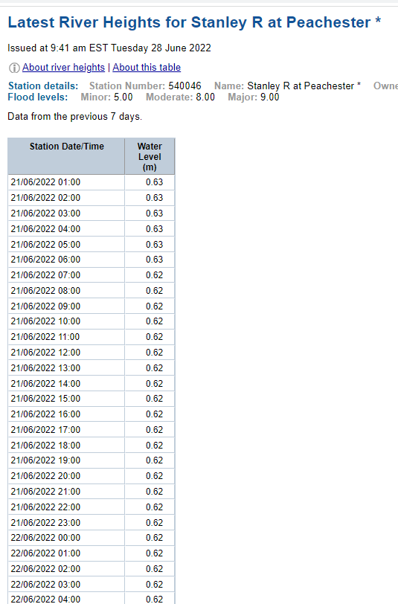
Notes:
Had to scrape it from the website – Jackson scraped it

Slide 13
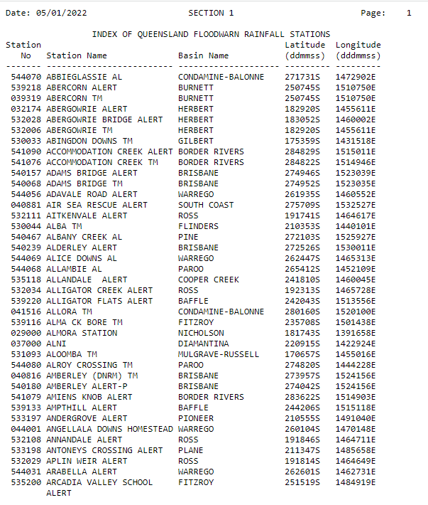


Notes:
Then had to search to find the location of these gauges – Raiha found the location

Slide 14

Georeference and rasterize the 2022 forecast
Notes:
There was no shapefile available – Matthew had to do this

Slide 15
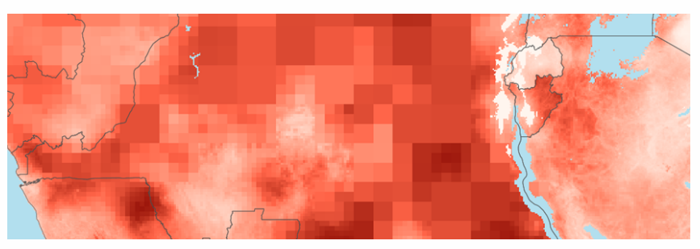
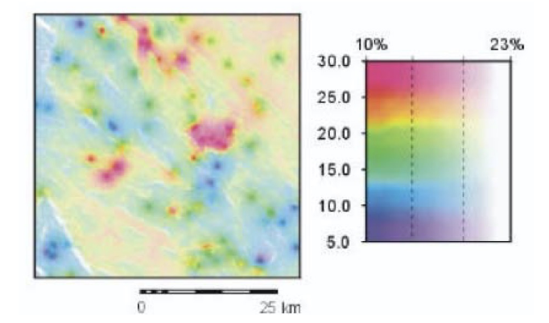
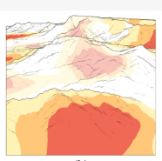

Incorporate uncertainty visualisation techniques
https://www.lancaster.ac.uk/data-science-of-the-natural-environment/blogs/visualising-spatial-uncertainty
Visser, H., Petersen, A. C., Beusen, A. H. W., Heuberger, P. S. C., & Janssen, P. H. M. (2006). Guidance for uncertainty assessment and communication. Report, 550032001, 2006.
Dübel, S., Röhlig, M., Tominski, C. and Schumann, H., 2017, February. Visualizing 3D terrain, geo-spatial data, and uncertainty. In Informatics (Vol. 4, No. 1, p. 6). MDPI.
Notes:
Reference that some of this is from Owen

Slide 16
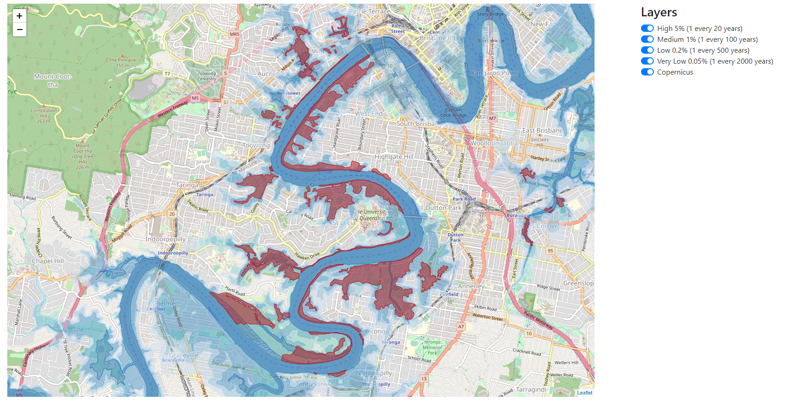


Our solution: a web-based, interactive platform to present real-time predictions
Notes:
Miguel created this – Larissa extracted the Copernicus imagery

Slide 17
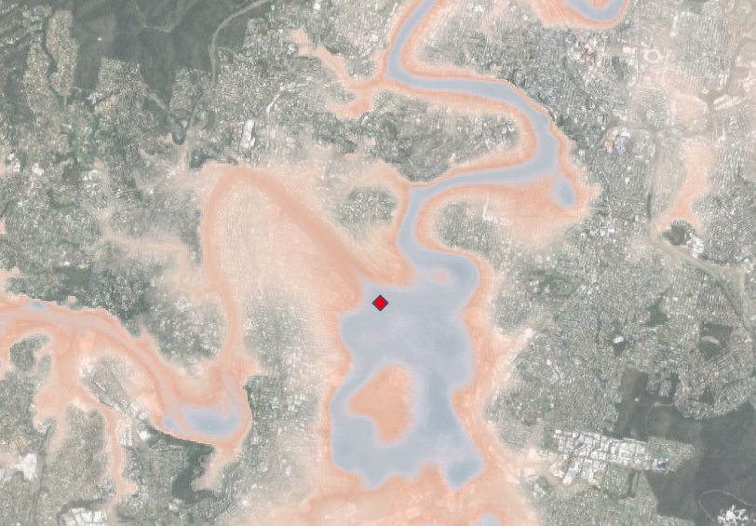
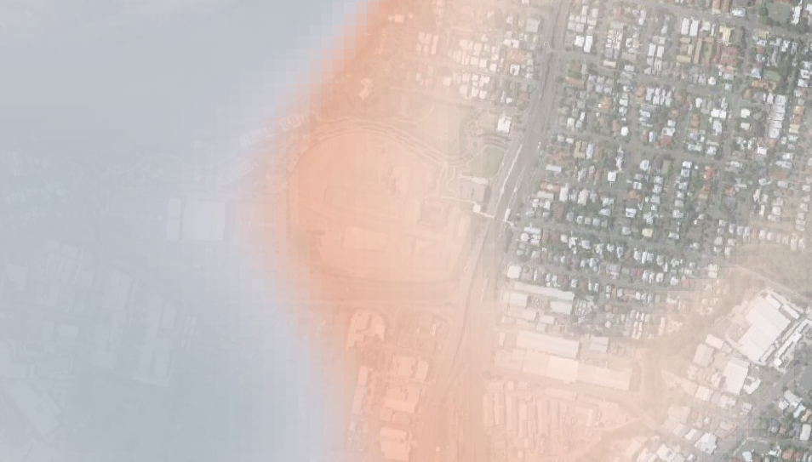

Slide 18
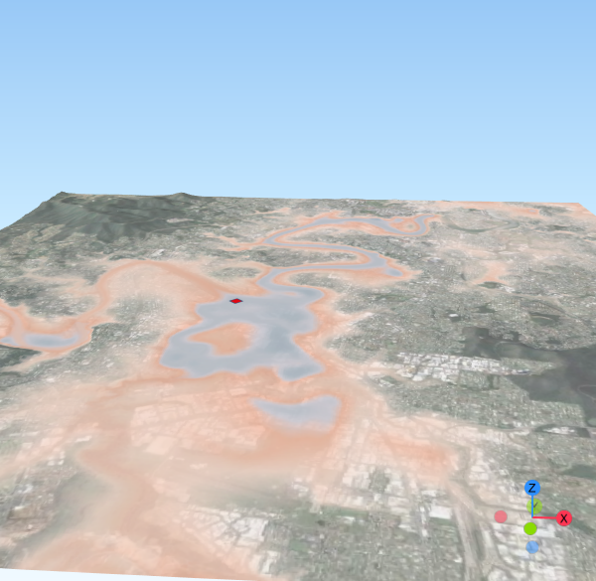

Slide 19


Take-home message
We should use available real-time data to update predictions of flood extent
Flood maps should be:
Interactive
Easily interpretable
Updated regularly
Representing uncertainty

